Slide 1

Week 7 – Lecture Notes
Find data to answer business questions

Slide 2
Content
An illustrative example
Find the data, “what” data, “which” data, “where” are the data
Answer to business questions, big or small
Is it an enterprise issues or BI issues (data issues)
Big data, BI, AI and future Logistics

Slide 3
Before this course
We don’t know “what” questions to ask.
We don’t know “where” the data is.
We don’t know “how” to bring them together.
We don’t know “what” answer we will get.
Notes:
What is logistics, Global Logistics picture, Australia logsitics Picture;
6 Major issues also apply to Australia and Defence
I will start with an overview of TE, and then I introduce the previous related to TE, so that you know what I have done in the past. This will form the basis for what I propose to do in the future, and my vision of transport engineering in 2050.
Summary Transportation Engineering
Vehicles,
Infrastructure,
Networks,
Carbon,
Strategy/Policy,
Collaborative Logistics
Engineering plan, policies and strategies
Application of technology and scientific principles to the planning, functional design, operation and management of facilities for any mode of transportation, to provide for the safe, rapid, comfortable, convenient, economical, and environmentally compatible movement of people and goods.
In Civil Engineering term, it is planning, design, construction, maintenance, and operation of transportation facilities.
There are several dimensions:
Aerospace and Air Transportation;
Highway; Road and Land Corridors
Traffic and congention engineering and management
Rail and Intermodals
Urban Transportation and operation and Planning
Pipeline; Waterway,
Port, Coastal and Ocean;
http://en.wikipedia.org/wiki/Transport_engineering
1 Highway engineering (Talk to Leo Poduta) (in Sydney Very speed limits, in Melbourne, they have 3 line in the morning to city and 2 line back, and in the afternoon, they have 3 way back from city and 2 line to the city. on ramp/off ramp, location, road network, determine of mix traffic,
2 Railroad engineering
3 Port and harbor engineering
4 Airport engineering
Bicycle transportation engineering
Intelligent Transportation System (ITS)
Pavement engineering (semi-trallors in WA, heat and frequency, mix traffic)
Principles of Intelligent Urbanism
Space syntax (pedestrian and vehicular analysis using similar techniques to standard transportation engineering)
Transportation forecasting
Transportation planning
Utility cycling

Slide 4
After this course
We know what question to ask.
We know what answer we want.
We know what answer they want.
We know what stakeholder want.
Notes:
What is logistics, Global Logistics picture, Australia logsitics Picture;
6 Major issues also apply to Australia and Defence
I will start with an overview of TE, and then I introduce the previous related to TE, so that you know what I have done in the past. This will form the basis for what I propose to do in the future, and my vision of transport engineering in 2050.
Summary Transportation Engineering
Vehicles,
Infrastructure,
Networks,
Carbon,
Strategy/Policy,
Collaborative Logistics
Engineering plan, policies and strategies
Application of technology and scientific principles to the planning, functional design, operation and management of facilities for any mode of transportation, to provide for the safe, rapid, comfortable, convenient, economical, and environmentally compatible movement of people and goods.
In Civil Engineering term, it is planning, design, construction, maintenance, and operation of transportation facilities.
There are several dimensions:
Aerospace and Air Transportation;
Highway; Road and Land Corridors
Traffic and congention engineering and management
Rail and Intermodals
Urban Transportation and operation and Planning
Pipeline; Waterway,
Port, Coastal and Ocean;
http://en.wikipedia.org/wiki/Transport_engineering
1 Highway engineering (Talk to Leo Poduta) (in Sydney Very speed limits, in Melbourne, they have 3 line in the morning to city and 2 line back, and in the afternoon, they have 3 way back from city and 2 line to the city. on ramp/off ramp, location, road network, determine of mix traffic,
2 Railroad engineering
3 Port and harbor engineering
4 Airport engineering
Bicycle transportation engineering
Intelligent Transportation System (ITS)
Pavement engineering (semi-trallors in WA, heat and frequency, mix traffic)
Principles of Intelligent Urbanism
Space syntax (pedestrian and vehicular analysis using similar techniques to standard transportation engineering)
Transportation forecasting
Transportation planning
Utility cycling

Slide 5
An illustrative example

Slide 6
Personal Tax Return
Issue: I am paying too much tax, $40k in FY 2020 (FY: final year 2019-2020).
Question: How can I get deductions from my 2020 Tax Return?
The outcome: A solution/method/tool will allow me to pay less Tax in 2020.
To get the deductions from your income tax, you need to find the data/records/evidence to help claiming the deductions, then you claim them on your 2020 tax return, examples are shown here:
Your work-related other expenses: home office expenses, computers, % utility bills, relocation etc -$20k
Your work-related travel: local, domestics, international, based on ATO reasonable allowance -$20k
Your rental properties: interests, repairs, agent fees, Income loss etc -$40k (2+ rental properties)
Your business: pay staff, insurance, legal, donations, membership, website, rental, workshop -$20k
Total Taxable income: -$100k
Tax paid/deducted by your employer on your income is $40k (PAYG).
After you lodged your tax return, Tax on your taxable income is less $5k.
The result of the Tax refund is you get extra $35k. What a life!
minus 100k or say reduced by $100k

Slide 7
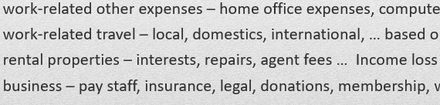
Can’t find data for big questions? Break big questions to smaller questions
So, the solution to achieve a good tax return, is to find the data and answer your question – “How to deduct tax?”
So, what data can answer this big question? You cannot find data for it?
Break a big question into smaller questions, so you can find the data to answer it!
ATO tax return Form have few boxes that allows you to enter the data to claim the deduction, as shown in the following (but not limited to the following):
These are sub-questions.
These are smaller questions and you can find the data to answer them.

Slide 8

“What” data, “which” data, “where” is the data
No data, no deduction, no tax refund, no fun at all.
Where the data are
What data, which data

Slide 9
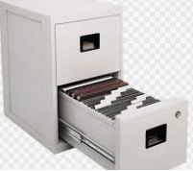
Find the data to answer your questions
Identify, specify, define, find and collect
What data? ---------------------------------> identify what data we need to answer to the questions
Which data? --------------------------------> select/elicit/specify data we need, not useless data
Where are the data? ---------------------> define where is the data located, the data sources
How to find the data? -------------------> find/access/pickup the specific data
How to bring the data together? -----> collect/consolidate/file/save the specific data
The solution - keeping the records/evidence/data, consolidate them together, add/delete, and then submit to your tax accountant with your records/evidence/data, then you can get big refund.
It’s a lot of money with a little effort, but if we have a system, it is once and for all - what a wonderful life!
Your personal Database

Slide 10
Why we have to find the data
Enterprise data is everywhere, no matter how much we invest

Slide 11
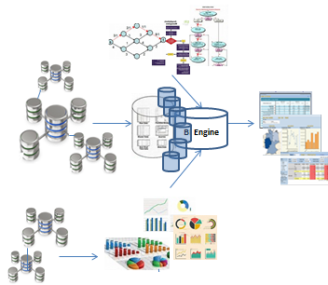
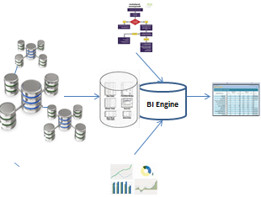
Enterprise data is all over the place, because of the dynamic nature of the business
10 years ago. Lots of back-end databases
10 years later. Lots of networks, each hosting lots of back-end databases
Notes:
What is logistics, Global Logistics picture, Australia logsitics Picture;
6 Major issues also apply to Australia and Defence
I will start with an overview of TE, and then I introduce the previous related to TE, so that you know what I have done in the past. This will form the basis for what I propose to do in the future, and my vision of transport engineering in 2050.
Summary Transportation Engineering
Vehicles,
Infrastructure,
Networks,
Carbon,
Strategy/Policy,
Collaborative Logistics
Engineering plan, policies and strategies
Application of technology and scientific principles to the planning, functional design, operation and management of facilities for any mode of transportation, to provide for the safe, rapid, comfortable, convenient, economical, and environmentally compatible movement of people and goods.
In Civil Engineering term, it is planning, design, construction, maintenance, and operation of transportation facilities.
There are several dimensions:
Aerospace and Air Transportation;
Highway; Road and Land Corridors
Traffic and congention engineering and management
Rail and Intermodals
Urban Transportation and operation and Planning
Pipeline; Waterway,
Port, Coastal and Ocean;
http://en.wikipedia.org/wiki/Transport_engineering
1 Highway engineering (Talk to Leo Poduta) (in Sydney Very speed limits, in Melbourne, they have 3 line in the morning to city and 2 line back, and in the afternoon, they have 3 way back from city and 2 line to the city. on ramp/off ramp, location, road network, determine of mix traffic,
2 Railroad engineering
3 Port and harbor engineering
4 Airport engineering
Bicycle transportation engineering
Intelligent Transportation System (ITS)
Pavement engineering (semi-trallors in WA, heat and frequency, mix traffic)
Principles of Intelligent Urbanism
Space syntax (pedestrian and vehicular analysis using similar techniques to standard transportation engineering)
Transportation forecasting
Transportation planning
Utility cycling

Slide 12
Ask Business Questions
There are too many issues facing our enterprise. Where do we start? Start asking questions, priorities those you can find
the data for it. Then you may have answers.
Small projects, small risks, delivery fast
and to the stakeholder satisfaction.

Slide 13
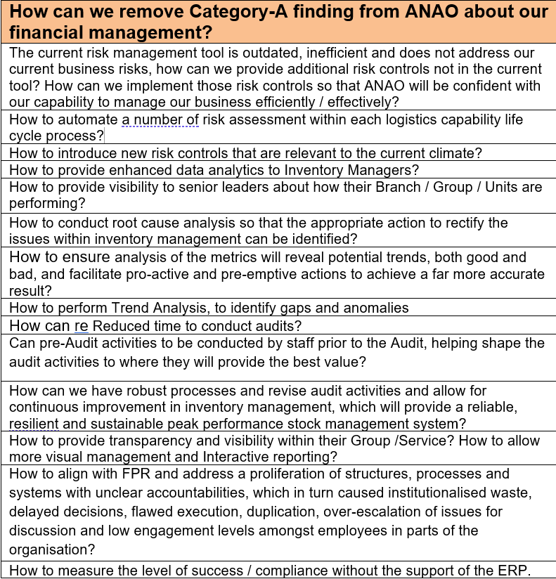
Small Questions lead big BI output – Sample 1
Notes:
What is logistics, Global Logistics picture, Australia logsitics Picture;
6 Major issues also apply to Australia and Defence
I will start with an overview of TE, and then I introduce the previous related to TE, so that you know what I have done in the past. This will form the basis for what I propose to do in the future, and my vision of transport engineering in 2050.
Summary Transportation Engineering
Vehicles,
Infrastructure,
Networks,
Carbon,
Strategy/Policy,
Collaborative Logistics
Engineering plan, policies and strategies
Application of technology and scientific principles to the planning, functional design, operation and management of facilities for any mode of transportation, to provide for the safe, rapid, comfortable, convenient, economical, and environmentally compatible movement of people and goods.
In Civil Engineering term, it is planning, design, construction, maintenance, and operation of transportation facilities.
There are several dimensions:
Aerospace and Air Transportation;
Highway; Road and Land Corridors
Traffic and congention engineering and management
Rail and Intermodals
Urban Transportation and operation and Planning
Pipeline; Waterway,
Port, Coastal and Ocean;
http://en.wikipedia.org/wiki/Transport_engineering
1 Highway engineering (Talk to Leo Poduta) (in Sydney Very speed limits, in Melbourne, they have 3 line in the morning to city and 2 line back, and in the afternoon, they have 3 way back from city and 2 line to the city. on ramp/off ramp, location, road network, determine of mix traffic,
2 Railroad engineering
3 Port and harbor engineering
4 Airport engineering
Bicycle transportation engineering
Intelligent Transportation System (ITS)
Pavement engineering (semi-trallors in WA, heat and frequency, mix traffic)
Principles of Intelligent Urbanism
Space syntax (pedestrian and vehicular analysis using similar techniques to standard transportation engineering)
Transportation forecasting
Transportation planning
Utility cycling

Slide 14
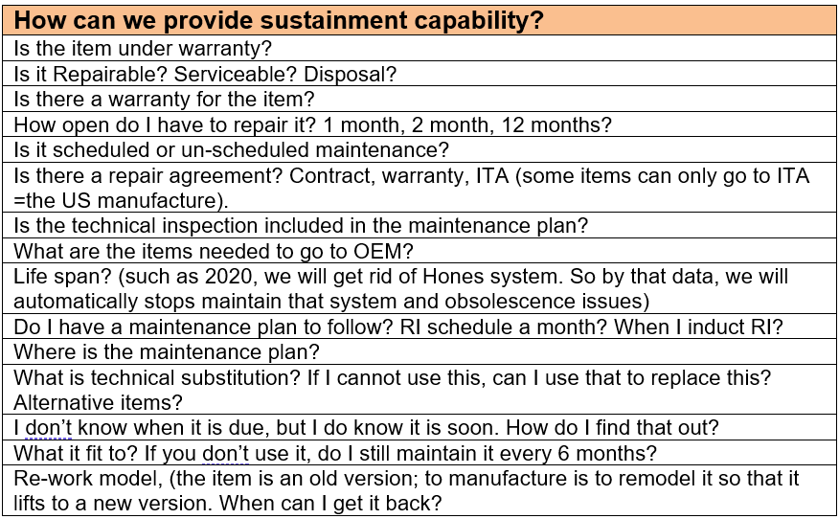
Small Questions lead to big BI output – Sample 2
Notes:
What is logistics, Global Logistics picture, Australia logsitics Picture;
6 Major issues also apply to Australia and Defence
I will start with an overview of TE, and then I introduce the previous related to TE, so that you know what I have done in the past. This will form the basis for what I propose to do in the future, and my vision of transport engineering in 2050.
Summary Transportation Engineering
Vehicles,
Infrastructure,
Networks,
Carbon,
Strategy/Policy,
Collaborative Logistics
Engineering plan, policies and strategies
Application of technology and scientific principles to the planning, functional design, operation and management of facilities for any mode of transportation, to provide for the safe, rapid, comfortable, convenient, economical, and environmentally compatible movement of people and goods.
In Civil Engineering term, it is planning, design, construction, maintenance, and operation of transportation facilities.
There are several dimensions:
Aerospace and Air Transportation;
Highway; Road and Land Corridors
Traffic and congention engineering and management
Rail and Intermodals
Urban Transportation and operation and Planning
Pipeline; Waterway,
Port, Coastal and Ocean;
http://en.wikipedia.org/wiki/Transport_engineering
1 Highway engineering (Talk to Leo Poduta) (in Sydney Very speed limits, in Melbourne, they have 3 line in the morning to city and 2 line back, and in the afternoon, they have 3 way back from city and 2 line to the city. on ramp/off ramp, location, road network, determine of mix traffic,
2 Railroad engineering
3 Port and harbor engineering
4 Airport engineering
Bicycle transportation engineering
Intelligent Transportation System (ITS)
Pavement engineering (semi-trallors in WA, heat and frequency, mix traffic)
Principles of Intelligent Urbanism
Space syntax (pedestrian and vehicular analysis using similar techniques to standard transportation engineering)
Transportation forecasting
Transportation planning
Utility cycling

Slide 15
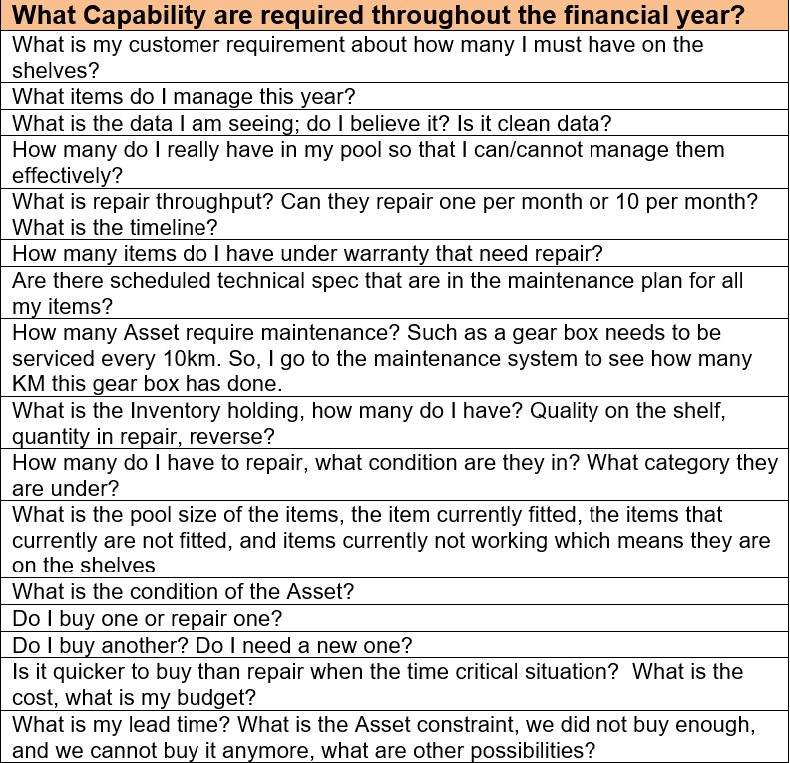
Small Questions lead to big BI output – Sample 3
Notes:
What is logistics, Global Logistics picture, Australia logsitics Picture;
6 Major issues also apply to Australia and Defence
I will start with an overview of TE, and then I introduce the previous related to TE, so that you know what I have done in the past. This will form the basis for what I propose to do in the future, and my vision of transport engineering in 2050.
Summary Transportation Engineering
Vehicles,
Infrastructure,
Networks,
Carbon,
Strategy/Policy,
Collaborative Logistics
Engineering plan, policies and strategies
Application of technology and scientific principles to the planning, functional design, operation and management of facilities for any mode of transportation, to provide for the safe, rapid, comfortable, convenient, economical, and environmentally compatible movement of people and goods.
In Civil Engineering term, it is planning, design, construction, maintenance, and operation of transportation facilities.
There are several dimensions:
Aerospace and Air Transportation;
Highway; Road and Land Corridors
Traffic and congention engineering and management
Rail and Intermodals
Urban Transportation and operation and Planning
Pipeline; Waterway,
Port, Coastal and Ocean;
http://en.wikipedia.org/wiki/Transport_engineering
1 Highway engineering (Talk to Leo Poduta) (in Sydney Very speed limits, in Melbourne, they have 3 line in the morning to city and 2 line back, and in the afternoon, they have 3 way back from city and 2 line to the city. on ramp/off ramp, location, road network, determine of mix traffic,
2 Railroad engineering
3 Port and harbor engineering
4 Airport engineering
Bicycle transportation engineering
Intelligent Transportation System (ITS)
Pavement engineering (semi-trallors in WA, heat and frequency, mix traffic)
Principles of Intelligent Urbanism
Space syntax (pedestrian and vehicular analysis using similar techniques to standard transportation engineering)
Transportation forecasting
Transportation planning
Utility cycling

Slide 16
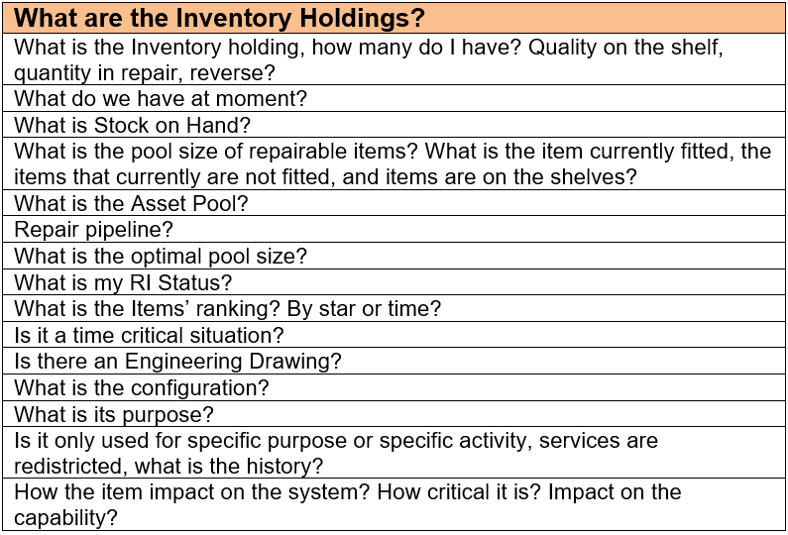
Small Questions lead to big BI output – Sample 4
Notes:
What is logistics, Global Logistics picture, Australia logsitics Picture;
6 Major issues also apply to Australia and Defence
I will start with an overview of TE, and then I introduce the previous related to TE, so that you know what I have done in the past. This will form the basis for what I propose to do in the future, and my vision of transport engineering in 2050.
Summary Transportation Engineering
Vehicles,
Infrastructure,
Networks,
Carbon,
Strategy/Policy,
Collaborative Logistics
Engineering plan, policies and strategies
Application of technology and scientific principles to the planning, functional design, operation and management of facilities for any mode of transportation, to provide for the safe, rapid, comfortable, convenient, economical, and environmentally compatible movement of people and goods.
In Civil Engineering term, it is planning, design, construction, maintenance, and operation of transportation facilities.
There are several dimensions:
Aerospace and Air Transportation;
Highway; Road and Land Corridors
Traffic and congention engineering and management
Rail and Intermodals
Urban Transportation and operation and Planning
Pipeline; Waterway,
Port, Coastal and Ocean;
http://en.wikipedia.org/wiki/Transport_engineering
1 Highway engineering (Talk to Leo Poduta) (in Sydney Very speed limits, in Melbourne, they have 3 line in the morning to city and 2 line back, and in the afternoon, they have 3 way back from city and 2 line to the city. on ramp/off ramp, location, road network, determine of mix traffic,
2 Railroad engineering
3 Port and harbor engineering
4 Airport engineering
Bicycle transportation engineering
Intelligent Transportation System (ITS)
Pavement engineering (semi-trallors in WA, heat and frequency, mix traffic)
Principles of Intelligent Urbanism
Space syntax (pedestrian and vehicular analysis using similar techniques to standard transportation engineering)
Transportation forecasting
Transportation planning
Utility cycling

Slide 17
Very Big Business Questions require Enterprise Solutions, not BI solutions
They relate to Big data and BI, but they are not Big data or BI issues, but enterprise issues. They could be large projects, with large investment and large risks. If you cannot find the data, it’s a waste of time and resources.

Slide 18
Example of Big Business Questions. They are not a part of BI, and would cost Billons of dollars
How can we have a single source of truth?
How can we have total ownership of our data?
What is RoI on deployment of ERP?
How can we interoperate between multiple isolated systems?
What is the best and agreed Business Intelligence framework?
Notes:
What is logistics, Global Logistics picture, Australia logsitics Picture;
6 Major issues also apply to Australia and Defence
I will start with an overview of TE, and then I introduce the previous related to TE, so that you know what I have done in the past. This will form the basis for what I propose to do in the future, and my vision of transport engineering in 2050.
Summary Transportation Engineering
Vehicles,
Infrastructure,
Networks,
Carbon,
Strategy/Policy,
Collaborative Logistics
Engineering plan, policies and strategies
Application of technology and scientific principles to the planning, functional design, operation and management of facilities for any mode of transportation, to provide for the safe, rapid, comfortable, convenient, economical, and environmentally compatible movement of people and goods.
In Civil Engineering term, it is planning, design, construction, maintenance, and operation of transportation facilities.
There are several dimensions:
Aerospace and Air Transportation;
Highway; Road and Land Corridors
Traffic and congention engineering and management
Rail and Intermodals
Urban Transportation and operation and Planning
Pipeline; Waterway,
Port, Coastal and Ocean;
http://en.wikipedia.org/wiki/Transport_engineering
1 Highway engineering (Talk to Leo Poduta) (in Sydney Very speed limits, in Melbourne, they have 3 line in the morning to city and 2 line back, and in the afternoon, they have 3 way back from city and 2 line to the city. on ramp/off ramp, location, road network, determine of mix traffic,
2 Railroad engineering
3 Port and harbor engineering
4 Airport engineering
Bicycle transportation engineering
Intelligent Transportation System (ITS)
Pavement engineering (semi-trallors in WA, heat and frequency, mix traffic)
Principles of Intelligent Urbanism
Space syntax (pedestrian and vehicular analysis using similar techniques to standard transportation engineering)
Transportation forecasting
Transportation planning
Utility cycling

Slide 19
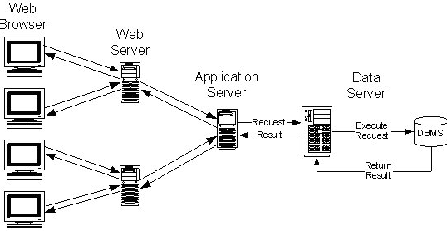
How can we have a single source of truth?
You need to identify the drawback of the traditional 3 tier or 4 tier Architectures and to understand why it allows data replication, duplication and redundancy
through Data Warehouse and Data Mart.
Data Warehouse, the 1990’s traditional approach
Notes:
What is logistics, Global Logistics picture, Australia logsitics Picture;
6 Major issues also apply to Australia and Defence
I will start with an overview of TE, and then I introduce the previous related to TE, so that you know what I have done in the past. This will form the basis for what I propose to do in the future, and my vision of transport engineering in 2050.
Summary Transportation Engineering
Vehicles,
Infrastructure,
Networks,
Carbon,
Strategy/Policy,
Collaborative Logistics
Engineering plan, policies and strategies
Application of technology and scientific principles to the planning, functional design, operation and management of facilities for any mode of transportation, to provide for the safe, rapid, comfortable, convenient, economical, and environmentally compatible movement of people and goods.
In Civil Engineering term, it is planning, design, construction, maintenance, and operation of transportation facilities.
There are several dimensions:
Aerospace and Air Transportation;
Highway; Road and Land Corridors
Traffic and congention engineering and management
Rail and Intermodals
Urban Transportation and operation and Planning
Pipeline; Waterway,
Port, Coastal and Ocean;
http://en.wikipedia.org/wiki/Transport_engineering
1 Highway engineering (Talk to Leo Poduta) (in Sydney Very speed limits, in Melbourne, they have 3 line in the morning to city and 2 line back, and in the afternoon, they have 3 way back from city and 2 line to the city. on ramp/off ramp, location, road network, determine of mix traffic,
2 Railroad engineering
3 Port and harbor engineering
4 Airport engineering
Bicycle transportation engineering
Intelligent Transportation System (ITS)
Pavement engineering (semi-trallors in WA, heat and frequency, mix traffic)
Principles of Intelligent Urbanism
Space syntax (pedestrian and vehicular analysis using similar techniques to standard transportation engineering)
Transportation forecasting
Transportation planning
Utility cycling

Slide 20
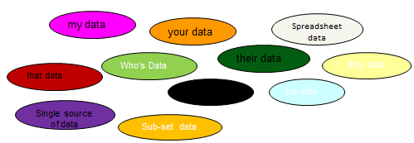
How can we have a single source of truth?
If you don’t take the ownership of the data, you will not be able to answer the following questions, because you outsourced - it remains unknown.
Where does she get data from?
How did you pull that data?
Do you trust that data?
Did you include their data?
How did you get this data?
Why that data is important?

Slide 21
How can we have a total ownership of our data?
You don’t if you outsource all your IT - everybody knows.
You need to address the following questions.
IT outsourcing
Vendor supported systems
IP and Copyrights
Poor IT contracts
Your Data, my server
Notes:
What is logistics, Global Logistics picture, Australia logsitics Picture;
6 Major issues also apply to Australia and Defence
I will start with an overview of TE, and then I introduce the previous related to TE, so that you know what I have done in the past. This will form the basis for what I propose to do in the future, and my vision of transport engineering in 2050.
Summary Transportation Engineering
Vehicles,
Infrastructure,
Networks,
Carbon,
Strategy/Policy,
Collaborative Logistics
Engineering plan, policies and strategies
Application of technology and scientific principles to the planning, functional design, operation and management of facilities for any mode of transportation, to provide for the safe, rapid, comfortable, convenient, economical, and environmentally compatible movement of people and goods.
In Civil Engineering term, it is planning, design, construction, maintenance, and operation of transportation facilities.
There are several dimensions:
Aerospace and Air Transportation;
Highway; Road and Land Corridors
Traffic and congention engineering and management
Rail and Intermodals
Urban Transportation and operation and Planning
Pipeline; Waterway,
Port, Coastal and Ocean;
http://en.wikipedia.org/wiki/Transport_engineering
1 Highway engineering (Talk to Leo Poduta) (in Sydney Very speed limits, in Melbourne, they have 3 line in the morning to city and 2 line back, and in the afternoon, they have 3 way back from city and 2 line to the city. on ramp/off ramp, location, road network, determine of mix traffic,
2 Railroad engineering
3 Port and harbor engineering
4 Airport engineering
Bicycle transportation engineering
Intelligent Transportation System (ITS)
Pavement engineering (semi-trallors in WA, heat and frequency, mix traffic)
Principles of Intelligent Urbanism
Space syntax (pedestrian and vehicular analysis using similar techniques to standard transportation engineering)
Transportation forecasting
Transportation planning
Utility cycling

Slide 22
What is RoI on deployment of ERP?
Worldwide, no single evidence of RoI on DW (Data Warehouses). Can you find it?
What you can find in the last 20 years, is that all the Data Warehouse projects have 100% failure to deliver RoI. Most of the public sector does not care. Can you fix this?
Inflexible – build by Expert
Require Expert to operate
Not for managers or end-users (of BI)
Expensive and slow improvement
Vendor in control
Notes:
What is logistics, Global Logistics picture, Australia logsitics Picture;
6 Major issues also apply to Australia and Defence
I will start with an overview of TE, and then I introduce the previous related to TE, so that you know what I have done in the past. This will form the basis for what I propose to do in the future, and my vision of transport engineering in 2050.
Summary Transportation Engineering
Vehicles,
Infrastructure,
Networks,
Carbon,
Strategy/Policy,
Collaborative Logistics
Engineering plan, policies and strategies
Application of technology and scientific principles to the planning, functional design, operation and management of facilities for any mode of transportation, to provide for the safe, rapid, comfortable, convenient, economical, and environmentally compatible movement of people and goods.
In Civil Engineering term, it is planning, design, construction, maintenance, and operation of transportation facilities.
There are several dimensions:
Aerospace and Air Transportation;
Highway; Road and Land Corridors
Traffic and congention engineering and management
Rail and Intermodals
Urban Transportation and operation and Planning
Pipeline; Waterway,
Port, Coastal and Ocean;
http://en.wikipedia.org/wiki/Transport_engineering
1 Highway engineering (Talk to Leo Poduta) (in Sydney Very speed limits, in Melbourne, they have 3 line in the morning to city and 2 line back, and in the afternoon, they have 3 way back from city and 2 line to the city. on ramp/off ramp, location, road network, determine of mix traffic,
2 Railroad engineering
3 Port and harbor engineering
4 Airport engineering
Bicycle transportation engineering
Intelligent Transportation System (ITS)
Pavement engineering (semi-trallors in WA, heat and frequency, mix traffic)
Principles of Intelligent Urbanism
Space syntax (pedestrian and vehicular analysis using similar techniques to standard transportation engineering)
Transportation forecasting
Transportation planning
Utility cycling

Slide 23
How can we interoperate between multiple isolated systems?
30 years on, no solutions to date. This is due to the fact that these different systems have the following features:
Vendor in control
Vendors – not willing to share the code or data
Need a Database Expert
Poor IT outsourcing strategy
Data alignment and Schema matching failed to keep pace with the Business Change
Notes:
What is logistics, Global Logistics picture, Australia logsitics Picture;
6 Major issues also apply to Australia and Defence
I will start with an overview of TE, and then I introduce the previous related to TE, so that you know what I have done in the past. This will form the basis for what I propose to do in the future, and my vision of transport engineering in 2050.
Summary Transportation Engineering
Vehicles,
Infrastructure,
Networks,
Carbon,
Strategy/Policy,
Collaborative Logistics
Engineering plan, policies and strategies
Application of technology and scientific principles to the planning, functional design, operation and management of facilities for any mode of transportation, to provide for the safe, rapid, comfortable, convenient, economical, and environmentally compatible movement of people and goods.
In Civil Engineering term, it is planning, design, construction, maintenance, and operation of transportation facilities.
There are several dimensions:
Aerospace and Air Transportation;
Highway; Road and Land Corridors
Traffic and congention engineering and management
Rail and Intermodals
Urban Transportation and operation and Planning
Pipeline; Waterway,
Port, Coastal and Ocean;
http://en.wikipedia.org/wiki/Transport_engineering
1 Highway engineering (Talk to Leo Poduta) (in Sydney Very speed limits, in Melbourne, they have 3 line in the morning to city and 2 line back, and in the afternoon, they have 3 way back from city and 2 line to the city. on ramp/off ramp, location, road network, determine of mix traffic,
2 Railroad engineering
3 Port and harbor engineering
4 Airport engineering
Bicycle transportation engineering
Intelligent Transportation System (ITS)
Pavement engineering (semi-trallors in WA, heat and frequency, mix traffic)
Principles of Intelligent Urbanism
Space syntax (pedestrian and vehicular analysis using similar techniques to standard transportation engineering)
Transportation forecasting
Transportation planning
Utility cycling

Slide 24
What is the best and agreed Business Intelligence framework?
This is an enterprise issue that is related to big data, but it is not a BI issues, one needs to answer to the follow questions.
Lack of understanding
Different understanding
Lack of BI expert
Lack of ICT investment
Notes:
What is logistics, Global Logistics picture, Australia logsitics Picture;
6 Major issues also apply to Australia and Defence
I will start with an overview of TE, and then I introduce the previous related to TE, so that you know what I have done in the past. This will form the basis for what I propose to do in the future, and my vision of transport engineering in 2050.
Summary Transportation Engineering
Vehicles,
Infrastructure,
Networks,
Carbon,
Strategy/Policy,
Collaborative Logistics
Engineering plan, policies and strategies
Application of technology and scientific principles to the planning, functional design, operation and management of facilities for any mode of transportation, to provide for the safe, rapid, comfortable, convenient, economical, and environmentally compatible movement of people and goods.
In Civil Engineering term, it is planning, design, construction, maintenance, and operation of transportation facilities.
There are several dimensions:
Aerospace and Air Transportation;
Highway; Road and Land Corridors
Traffic and congention engineering and management
Rail and Intermodals
Urban Transportation and operation and Planning
Pipeline; Waterway,
Port, Coastal and Ocean;
http://en.wikipedia.org/wiki/Transport_engineering
1 Highway engineering (Talk to Leo Poduta) (in Sydney Very speed limits, in Melbourne, they have 3 line in the morning to city and 2 line back, and in the afternoon, they have 3 way back from city and 2 line to the city. on ramp/off ramp, location, road network, determine of mix traffic,
2 Railroad engineering
3 Port and harbor engineering
4 Airport engineering
Bicycle transportation engineering
Intelligent Transportation System (ITS)
Pavement engineering (semi-trallors in WA, heat and frequency, mix traffic)
Principles of Intelligent Urbanism
Space syntax (pedestrian and vehicular analysis using similar techniques to standard transportation engineering)
Transportation forecasting
Transportation planning
Utility cycling

Slide 25
What Big data project can do?
Single source of truth
Total ownership of all the data
Return on Investment through BI
End-to-end data visibility through single entry
Automated BI powered by AI
Notes:
What is logistics, Global Logistics picture, Australia logsitics Picture;
6 Major issues also apply to Australia and Defence
I will start with an overview of TE, and then I introduce the previous related to TE, so that you know what I have done in the past. This will form the basis for what I propose to do in the future, and my vision of transport engineering in 2050.
Summary Transportation Engineering
Vehicles,
Infrastructure,
Networks,
Carbon,
Strategy/Policy,
Collaborative Logistics
Engineering plan, policies and strategies
Application of technology and scientific principles to the planning, functional design, operation and management of facilities for any mode of transportation, to provide for the safe, rapid, comfortable, convenient, economical, and environmentally compatible movement of people and goods.
In Civil Engineering term, it is planning, design, construction, maintenance, and operation of transportation facilities.
There are several dimensions:
Aerospace and Air Transportation;
Highway; Road and Land Corridors
Traffic and congention engineering and management
Rail and Intermodals
Urban Transportation and operation and Planning
Pipeline; Waterway,
Port, Coastal and Ocean;
http://en.wikipedia.org/wiki/Transport_engineering
1 Highway engineering (Talk to Leo Poduta) (in Sydney Very speed limits, in Melbourne, they have 3 line in the morning to city and 2 line back, and in the afternoon, they have 3 way back from city and 2 line to the city. on ramp/off ramp, location, road network, determine of mix traffic,
2 Railroad engineering
3 Port and harbor engineering
4 Airport engineering
Bicycle transportation engineering
Intelligent Transportation System (ITS)
Pavement engineering (semi-trallors in WA, heat and frequency, mix traffic)
Principles of Intelligent Urbanism
Space syntax (pedestrian and vehicular analysis using similar techniques to standard transportation engineering)
Transportation forecasting
Transportation planning
Utility cycling

Slide 26
Big data, BI and AI
An introduction

Slide 27
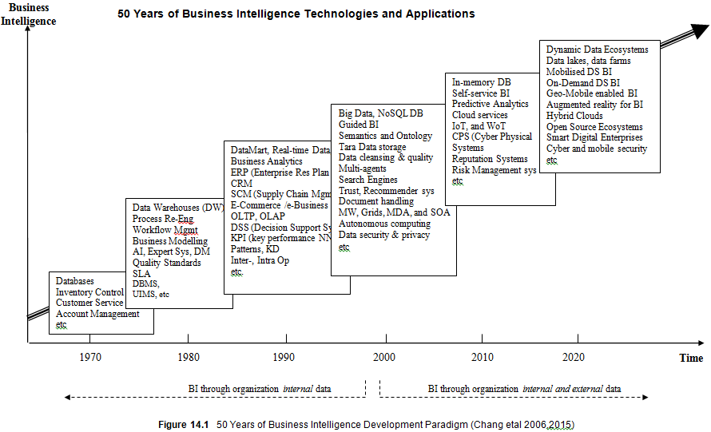
BI 5.0 (Data lake and Blockchain)
BI 4.0 (Clouds)
BI 3.0 (In memory
and Non-SQL)
BI 2.0 (ERP and Data Data mart)
BI 1.0 (Data Warehouse)
BI 0.0 (DBMS)

Slide 28
BI 5.0 (Data lake and Blockchain)
Where we are at
BI 4.0 (Clouds)
BI 3.0 (In memory
and Non-SQL)
BI 2.0 (ERP and Data Data mart)
BI 1.0 (Data Warehouse)
BI 0.0 (DBMS)

Slide 29
BI 5.0 (Data lake and Blockchain)
Where we want to be
BI 4.0 (Clouds)
BI 3.0 (In memory
and Non-SQL)
BI 2.0 (ERP and Data Data mart)
BI 1.0 (Data Warehouse)
BI 0.0 (DBMS)

Slide 30
BI 2020
Automated BI
Powered by AI
Self-service BI
Guided Analytics
2020
2010
2000

Slide 31
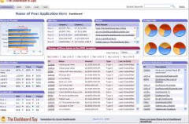
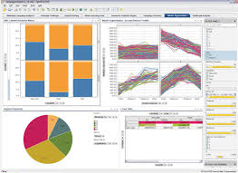
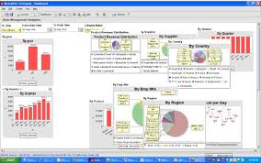
Traditional Data Warehouses and today’s BI
ERP and Data Warehouse are too complex and too difficult to use for managers or end- users. Traditional ERP or Data Warehouses give plenty of tables and graphs, but no decisions, and no recommendations.
Today BI is part of every employee. BI is an add-on to the current systems to provide diagnostic, predictive and prescriptive analytics. To help decision making, from what we have now to what we should do now and future.

Slide 32
Business Analytics vs Business Intelligence
Not a lot of data, tables, reports etc => but a picture worth 1000 words
Not a lot of graphics => but a decision support or recommendation(s)
Not what you have or you do not have => but what you have to do => such as 1,2,3,4
Not what is happening now => but future prediction or near future

Slide 33
Enterprise big data
Not Organization but User generated content
Organization External Data
Organization Internal Data
Database usage Log
User behaviour Log
Networks and Host Logs
Applications access Log
User decision making data
User’s operation model and simulation data
Cognitive process data
Opinions and Emails
Analytics results and recommendations
Complaints and complements
95% are txt and strings
Customers Data
Partners data
Market data collected at Org own choice
Web data
Social Media Data
External contracts
Files and images or evidences submitted
Surveillance and sensor data
Cyber security data
95% are unstructured
Operational Data
Sales, customers Data
HR and performance data
Enterprise raw data from DBs & ERPs
Organization Internal Collected Data, such as projects and files
documents, policies, manuals, reports 95% are structured

Slide 34
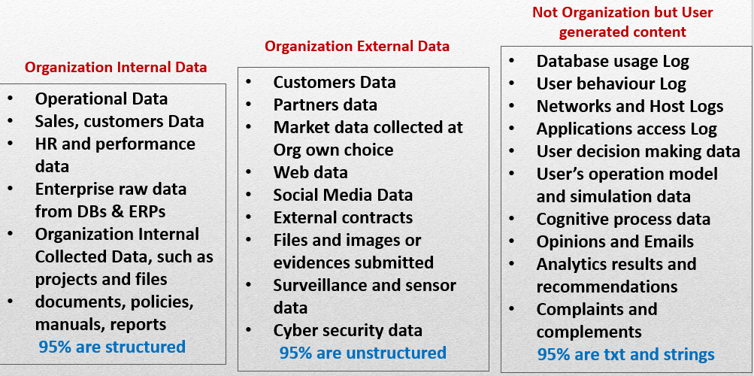
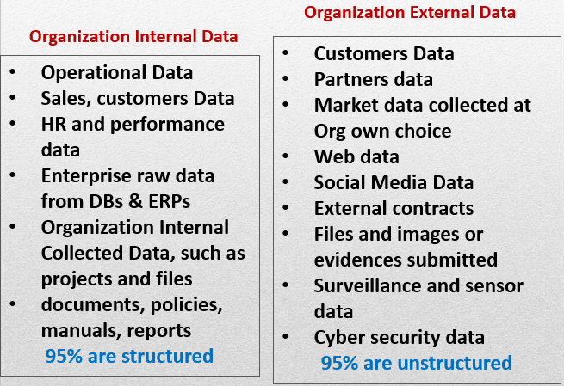
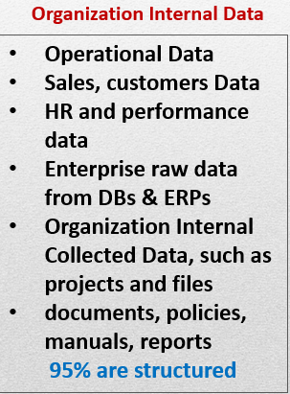
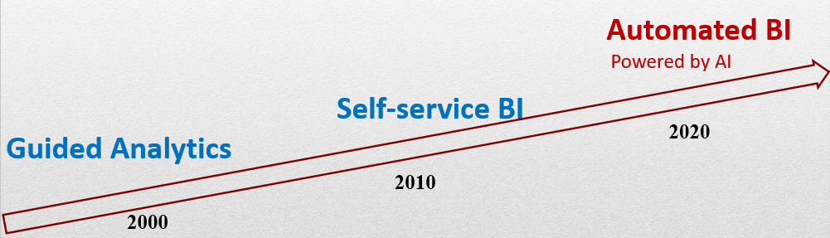
BI in 2020

Slide 35
BI Support Enterprise Vision
Capture decision making processes
Capture intellectual property
Capture organizational core knowledge
Capture real asset, values and human capital
Capture critical part of BI
Notes:
What is logistics, Global Logistics picture, Australia logsitics Picture;
6 Major issues also apply to Australia and Defence
I will start with an overview of TE, and then I introduce the previous related to TE, so that you know what I have done in the past. This will form the basis for what I propose to do in the future, and my vision of transport engineering in 2050.
Summary Transportation Engineering
Vehicles,
Infrastructure,
Networks,
Carbon,
Strategy/Policy,
Collaborative Logistics
Engineering plan, policies and strategies
Application of technology and scientific principles to the planning, functional design, operation and management of facilities for any mode of transportation, to provide for the safe, rapid, comfortable, convenient, economical, and environmentally compatible movement of people and goods.
In Civil Engineering term, it is planning, design, construction, maintenance, and operation of transportation facilities.
There are several dimensions:
Aerospace and Air Transportation;
Highway; Road and Land Corridors
Traffic and congention engineering and management
Rail and Intermodals
Urban Transportation and operation and Planning
Pipeline; Waterway,
Port, Coastal and Ocean;
http://en.wikipedia.org/wiki/Transport_engineering
1 Highway engineering (Talk to Leo Poduta) (in Sydney Very speed limits, in Melbourne, they have 3 line in the morning to city and 2 line back, and in the afternoon, they have 3 way back from city and 2 line to the city. on ramp/off ramp, location, road network, determine of mix traffic,
2 Railroad engineering
3 Port and harbor engineering
4 Airport engineering
Bicycle transportation engineering
Intelligent Transportation System (ITS)
Pavement engineering (semi-trallors in WA, heat and frequency, mix traffic)
Principles of Intelligent Urbanism
Space syntax (pedestrian and vehicular analysis using similar techniques to standard transportation engineering)
Transportation forecasting
Transportation planning
Utility cycling

Slide 36
Should BI be Outsourced?
Capture decision making processes
Capture intellectual property
Capture organizational core knowledge
Capture real asset, values, volume, human capital
Capture business secrets
Do you want someone to manage your bank accounts?
Notes:
What is logistics, Global Logistics picture, Australia logsitics Picture;
6 Major issues also apply to Australia and Defence
I will start with an overview of TE, and then I introduce the previous related to TE, so that you know what I have done in the past. This will form the basis for what I propose to do in the future, and my vision of transport engineering in 2050.
Summary Transportation Engineering
Vehicles,
Infrastructure,
Networks,
Carbon,
Strategy/Policy,
Collaborative Logistics
Engineering plan, policies and strategies
Application of technology and scientific principles to the planning, functional design, operation and management of facilities for any mode of transportation, to provide for the safe, rapid, comfortable, convenient, economical, and environmentally compatible movement of people and goods.
In Civil Engineering term, it is planning, design, construction, maintenance, and operation of transportation facilities.
There are several dimensions:
Aerospace and Air Transportation;
Highway; Road and Land Corridors
Traffic and congention engineering and management
Rail and Intermodals
Urban Transportation and operation and Planning
Pipeline; Waterway,
Port, Coastal and Ocean;
http://en.wikipedia.org/wiki/Transport_engineering
1 Highway engineering (Talk to Leo Poduta) (in Sydney Very speed limits, in Melbourne, they have 3 line in the morning to city and 2 line back, and in the afternoon, they have 3 way back from city and 2 line to the city. on ramp/off ramp, location, road network, determine of mix traffic,
2 Railroad engineering
3 Port and harbor engineering
4 Airport engineering
Bicycle transportation engineering
Intelligent Transportation System (ITS)
Pavement engineering (semi-trallors in WA, heat and frequency, mix traffic)
Principles of Intelligent Urbanism
Space syntax (pedestrian and vehicular analysis using similar techniques to standard transportation engineering)
Transportation forecasting
Transportation planning
Utility cycling

Slide 37
Should BI be Outsourced?

Slide 38




Should BI be Outsourced?
Capture Org Knowledge, Human and Intellectual Capital
Capture future products and services
Capture Org Operation, Performance and
Finance

Slide 39


Outsourcing Vicious Cycle
They don’t know what we want!
Customers
- Headquarters
- Executives
- Divisions
- Groups
- Units
- Sites
- Teams
- etc
IT Group
- CIO, CTO
- COO, CDO
- Capability Group
- Inventory Reform
- Head of IT
- DB administration
- Network officers
- Infrastructure officers
Outsource IT
- Software Vendors
- Business Consulting
- COTS providers
- Consultants
- etc.
They don’t know what they want!

Slide 40

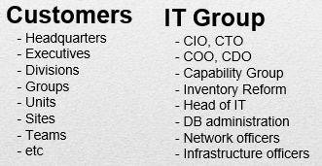
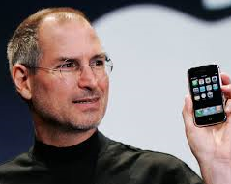
You – leading the Enterprise Innovation
Can Analyse and Deliver!
Can help customers find out what they want!

Slide 41
From Big data to AI
The process of finding Data for business questions is a process of analysis Stakeholders needs and priorities.
Modern front-end data lake or blockchain provide clean, aggregated data to the stakeholders from different Transactional databases such as Data Warehouse systems. It will be capable of delivering more accurate data and minimizing lead times between the demand and the decision support.
The reduction of the lead times requires an optimization of the process of the integrated data sources through AI and Blockchain.

Slide 42
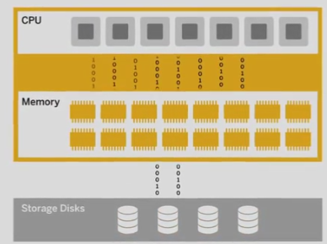
Powered by In-Memory DB
http://go.sap.com
Multi-core processes,
massive parallel
10x faster
Compression tech
9x
Logging and back up
Persistent DB
High Speed, Real Time (Analytics, Application and platform),
Structured and Unstructured Data, 100% ACID compliant, 1st release Nov 2010

Slide 43
In-Memory DB
1TB RAM, support 5 TB uncompressed Data 2010
8 TB RAM, support 40 TB uncompressed Data 2011
100 TB RAM, support 500 TB uncompressed Data 2012
(Hardware/super computers, IBM, HP, Dell, NEC etc, ..)
Today most large public sectors: over 3000 employees…. With duplicate 20-50 TB
Today large private sector: over 10,000 employee 100TB-500TB …

Slide 44
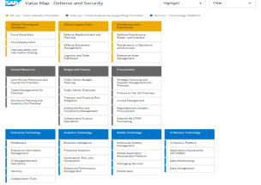
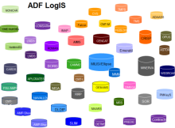

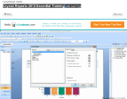

BI Out-sourcing
DW –ERP Back-End Operation
Enterprise 50+ IS
Parallel Access
Parallel Access
Front-end
Parallel Access

Slide 45



In-house Capability
DW - ERP Back-End
50+ IS
Cloud migration
DDM – Front-end BI
Our-sourcing
In-House Capability

Slide 46
From Big Data to Big Impact
Cognitive Decision support
Mobile and smart device enabled
No office, no desktop, analysis at anytime, anywhere and in real time
Agile, dynamic, and automated
On-Demand Decision Support
Rapid recommendation support
Sustainable through Self-organization,
Distributed trust and blockchain for enterprise data security.
Very good for Social Distancing

Slide 47
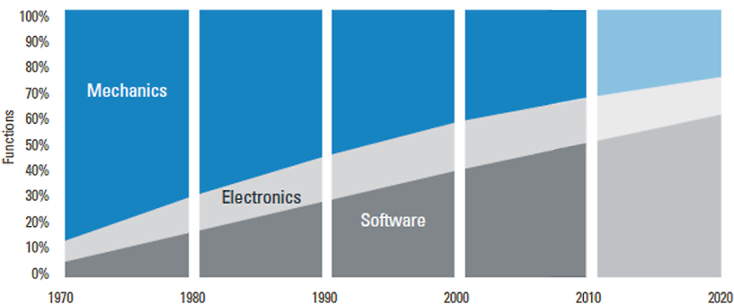
Future Capability - powered by Data and Software
Source: VDMA Future Trend Analysis

Slide 48
Future Capability - powered by Data and Software
Steadily increasing of automation software
New techniques are to reduce complexity

Slide 49
Future Logistics powered by Big data and AI
An overview

Slide 50

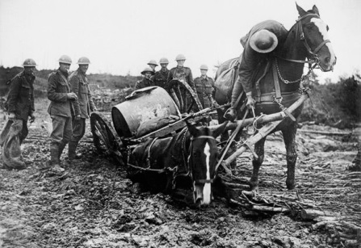
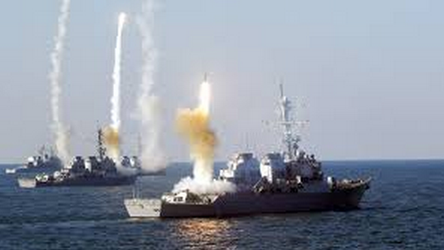


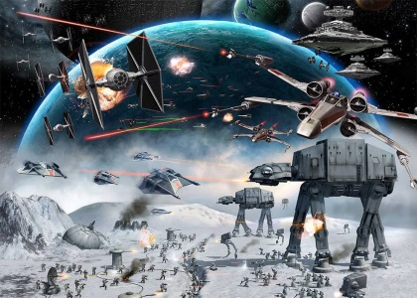
Defence Logistics Modernization
5000 years of history, 2000BC vs 2000 AC, Powered by Technology
Front-line officer Logisticians Centaury Ratio
1
99 Logisticians
18c 1:99
19c 1:50+tech
1
50 Logisticians and Technologies
20c 50:50 Civil - Mil
0
Tech – Cyber Physical Systems
21c 0 + Robots
Powered by ICT and Engineering

Slide 51
Conclusion
Issues and Question with data
50 years of BI – Where we are at
Logistics – Where we are going
Notes:
What is logistics, Global Logistics picture, Australia logsitics Picture;
6 Major issues also apply to Australia and Defence
I will start with an overview of TE, and then I introduce the previous related to TE, so that you know what I have done in the past. This will form the basis for what I propose to do in the future, and my vision of transport engineering in 2050.
Summary Transportation Engineering
Vehicles,
Infrastructure,
Networks,
Carbon,
Strategy/Policy,
Collaborative Logistics
Engineering plan, policies and strategies
Application of technology and scientific principles to the planning, functional design, operation and management of facilities for any mode of transportation, to provide for the safe, rapid, comfortable, convenient, economical, and environmentally compatible movement of people and goods.
In Civil Engineering term, it is planning, design, construction, maintenance, and operation of transportation facilities.
There are several dimensions:
Aerospace and Air Transportation;
Highway; Road and Land Corridors
Traffic and congention engineering and management
Rail and Intermodals
Urban Transportation and operation and Planning
Pipeline; Waterway,
Port, Coastal and Ocean;
http://en.wikipedia.org/wiki/Transport_engineering
1 Highway engineering (Talk to Leo Poduta) (in Sydney Very speed limits, in Melbourne, they have 3 line in the morning to city and 2 line back, and in the afternoon, they have 3 way back from city and 2 line to the city. on ramp/off ramp, location, road network, determine of mix traffic,
2 Railroad engineering
3 Port and harbor engineering
4 Airport engineering
Bicycle transportation engineering
Intelligent Transportation System (ITS)
Pavement engineering (semi-trallors in WA, heat and frequency, mix traffic)
Principles of Intelligent Urbanism
Space syntax (pedestrian and vehicular analysis using similar techniques to standard transportation engineering)
Transportation forecasting
Transportation planning
Utility cycling

